Slide 1
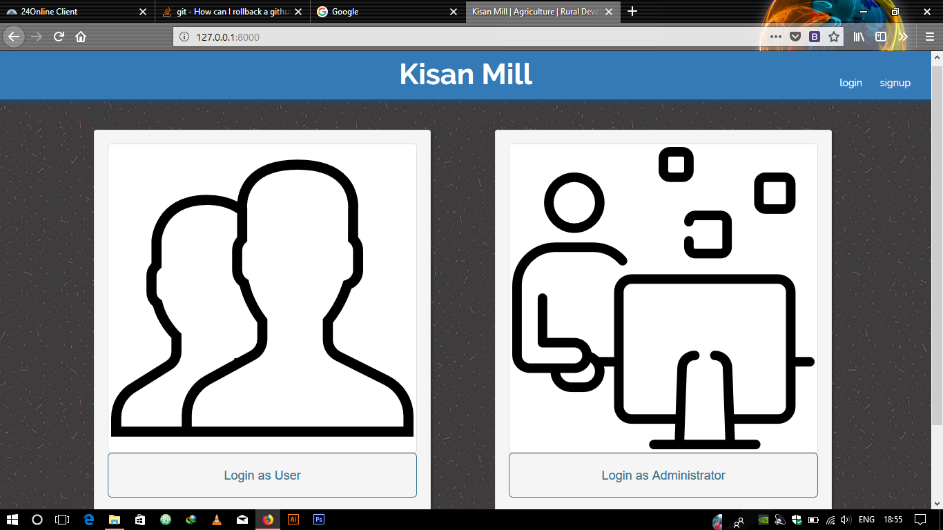
Main Page of the Product

Slide 2
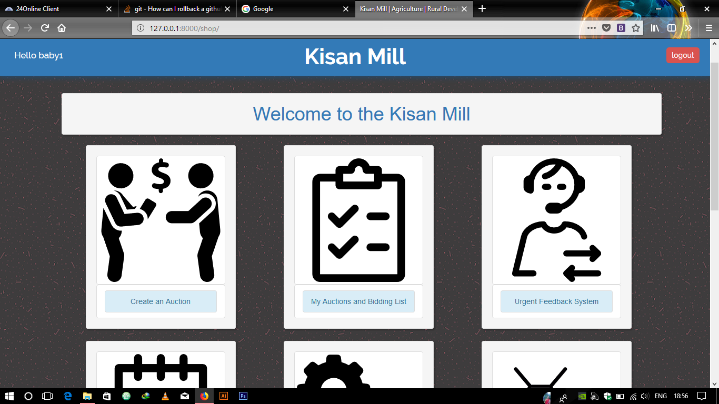
Main Shop Page with all options
Section – 1 : Options For Farmers

Slide 3
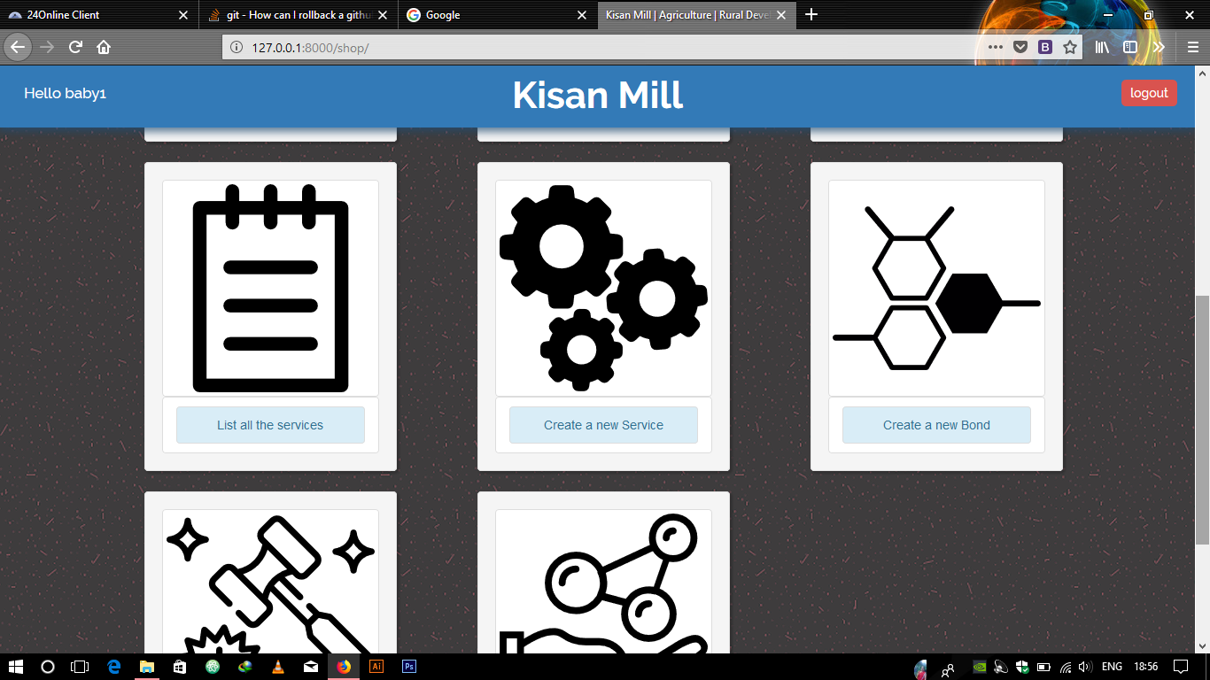
Main Shop Page with all options
Section - 2 : Service Creator and For the farmers

Slide 4
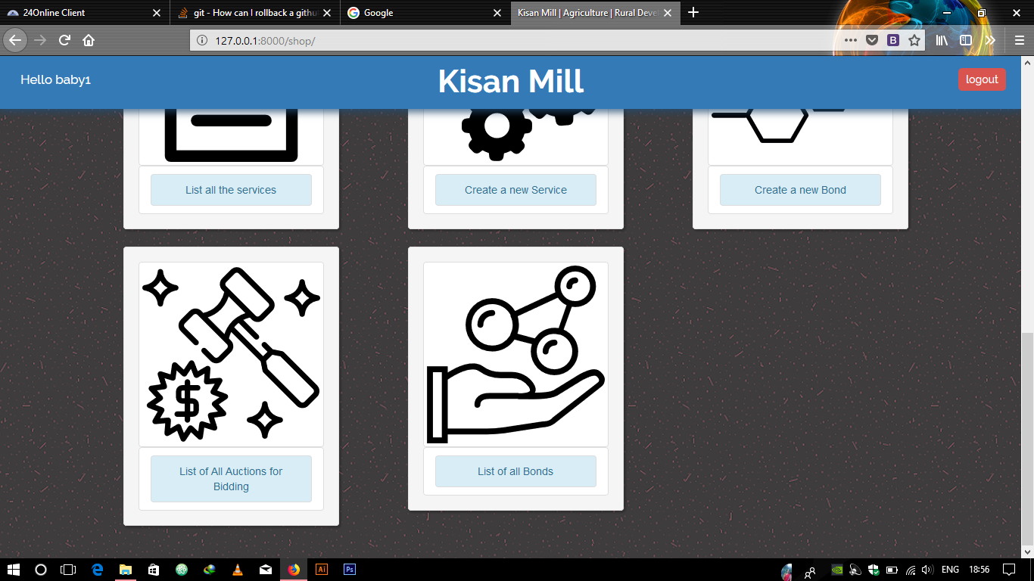
Main Shop Page with all options
Section - 3 : For the farmers

Slide 5
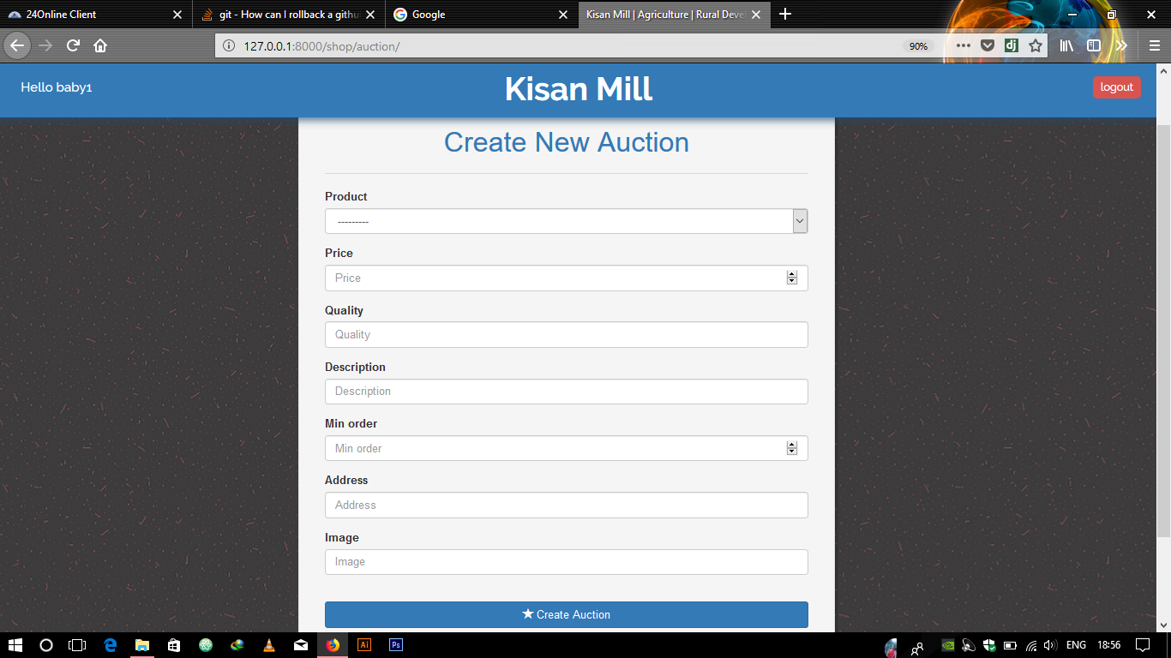
Create an auction for the crop

Slide 6
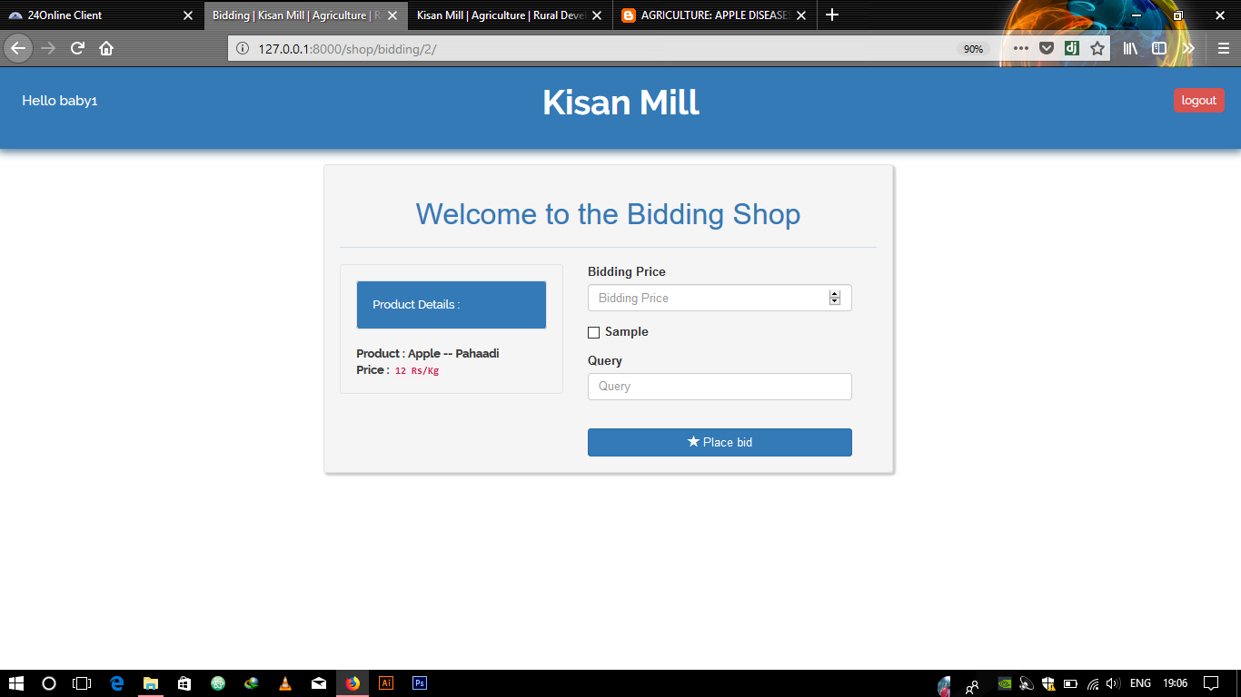
Bidding on the auction

Slide 7
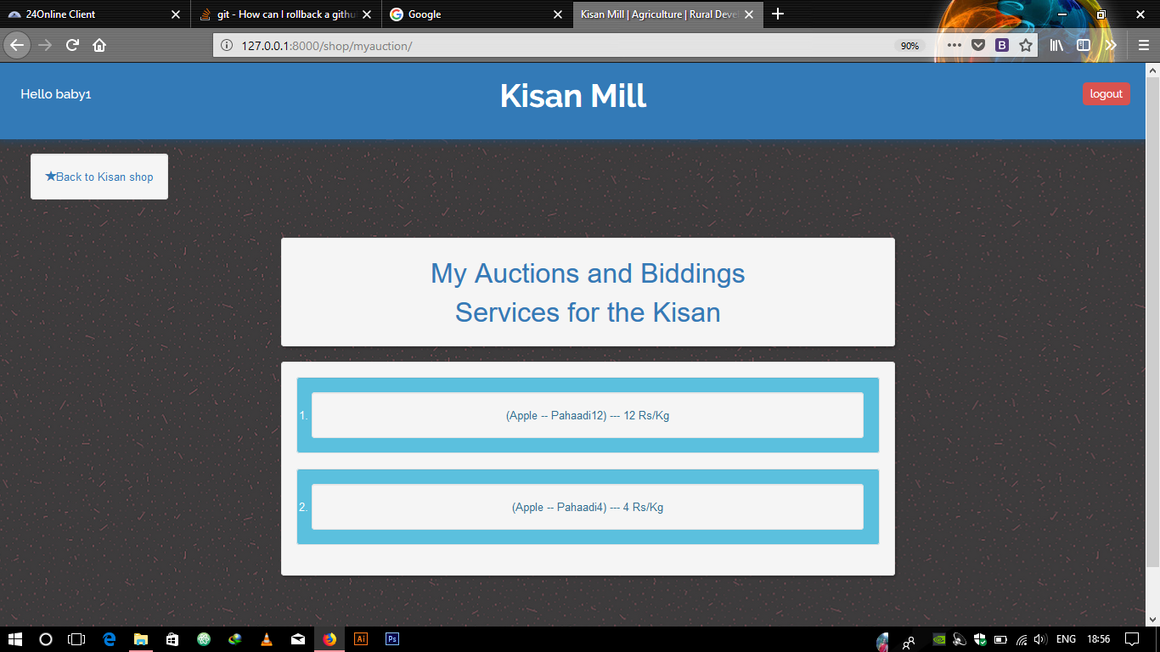
My auctions

Slide 8
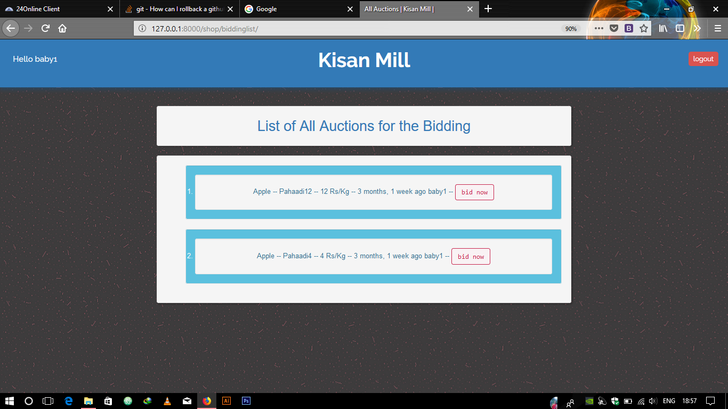
All Biddings on my allauctions
All the bidding on my auction

Slide 9
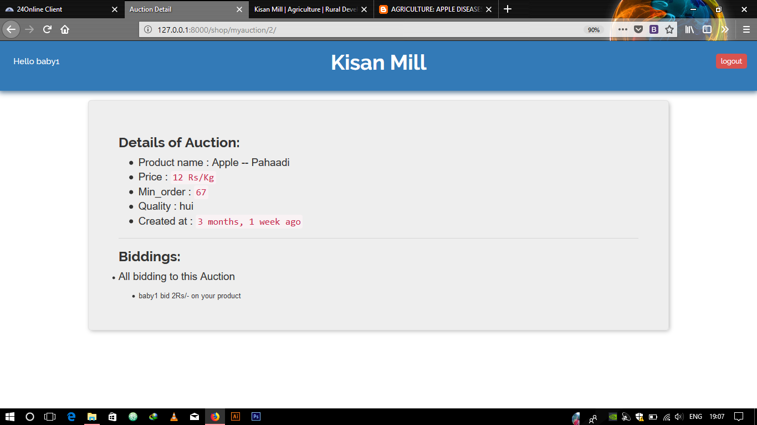
Detail of all bidding on a auctions
All the bidding on my auction

Slide 10
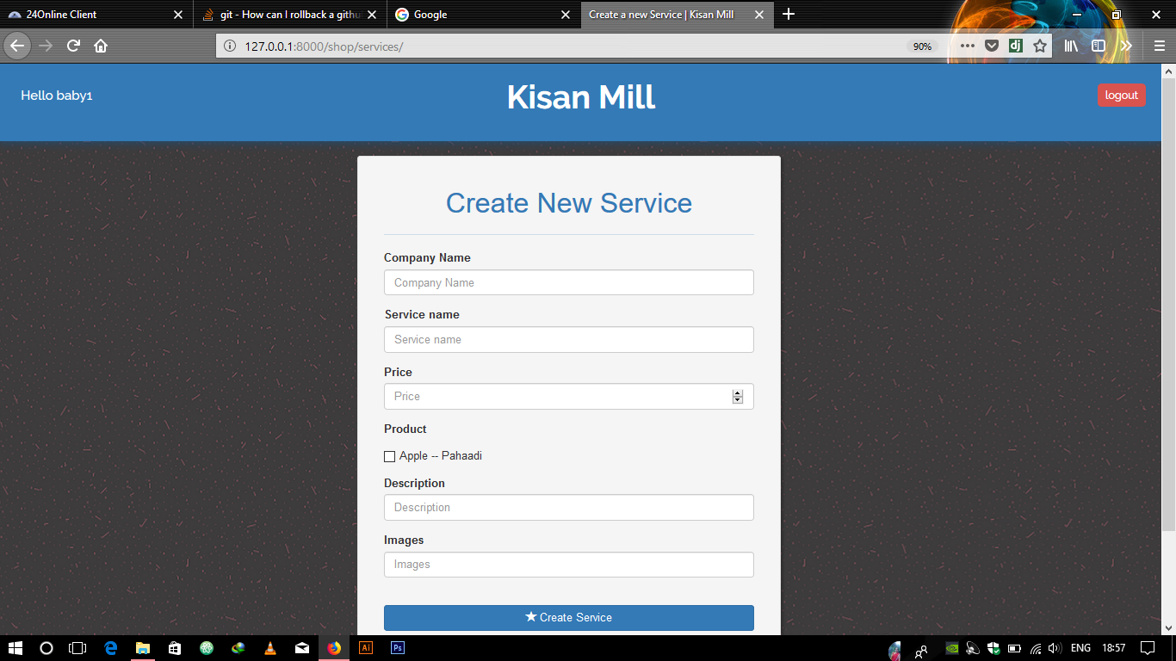
Creating a service for the farmer
Note : We are using links of the images of their services to show it as simple as possible.

Slide 11
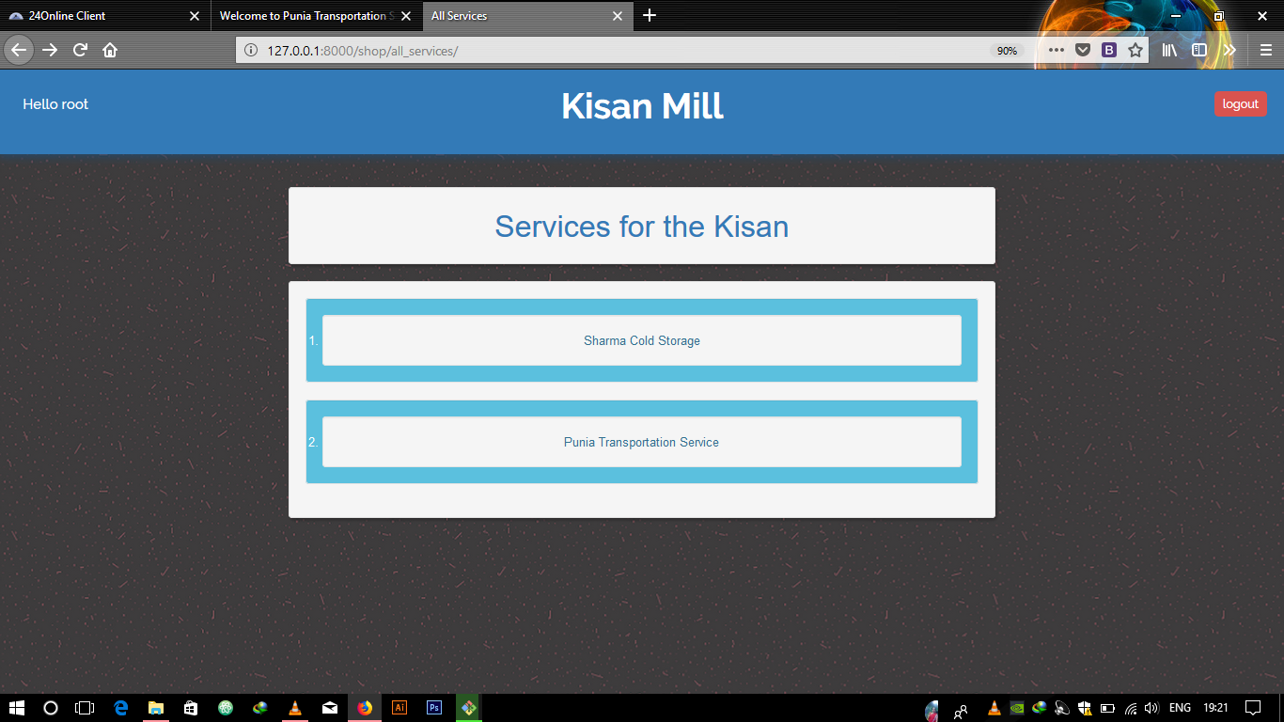
Listing all the services

Slide 12
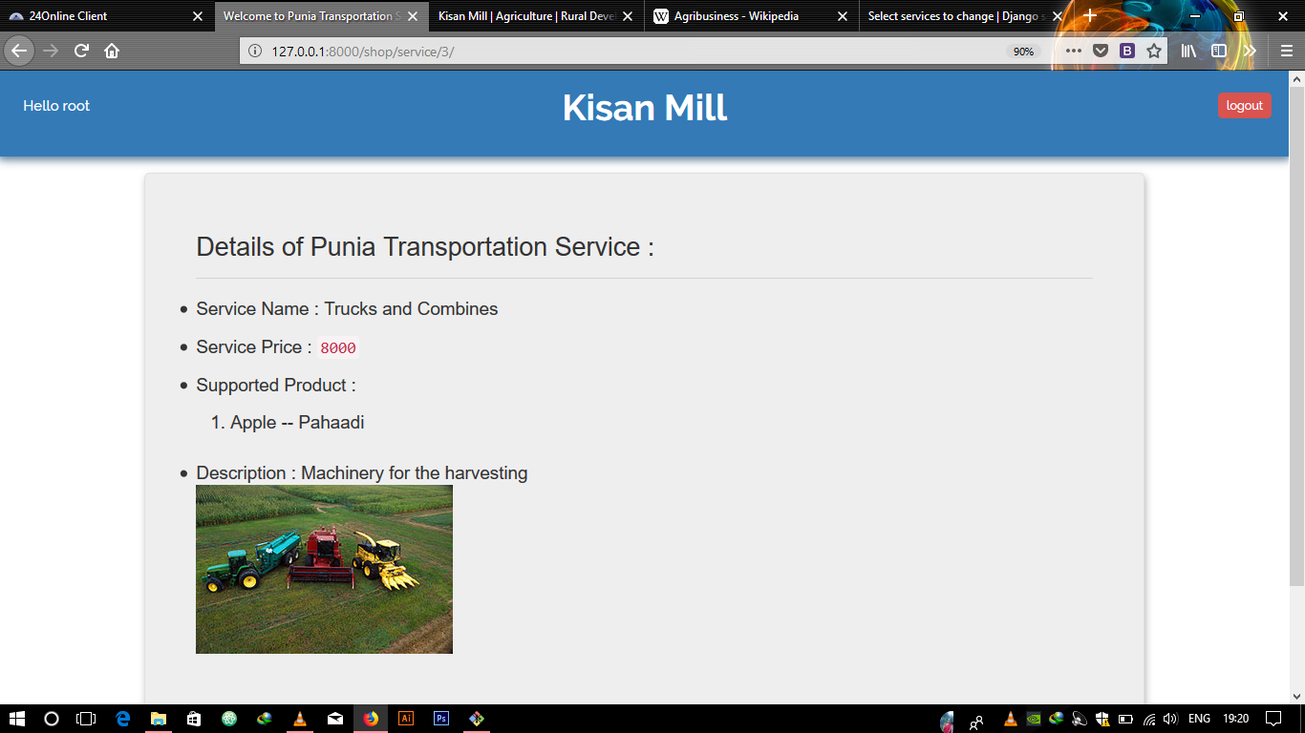
Detail of the service
It will show all the details of the service like images and reviews of the service.
We can also give the functionality of adding Google map in the interface.

Slide 13
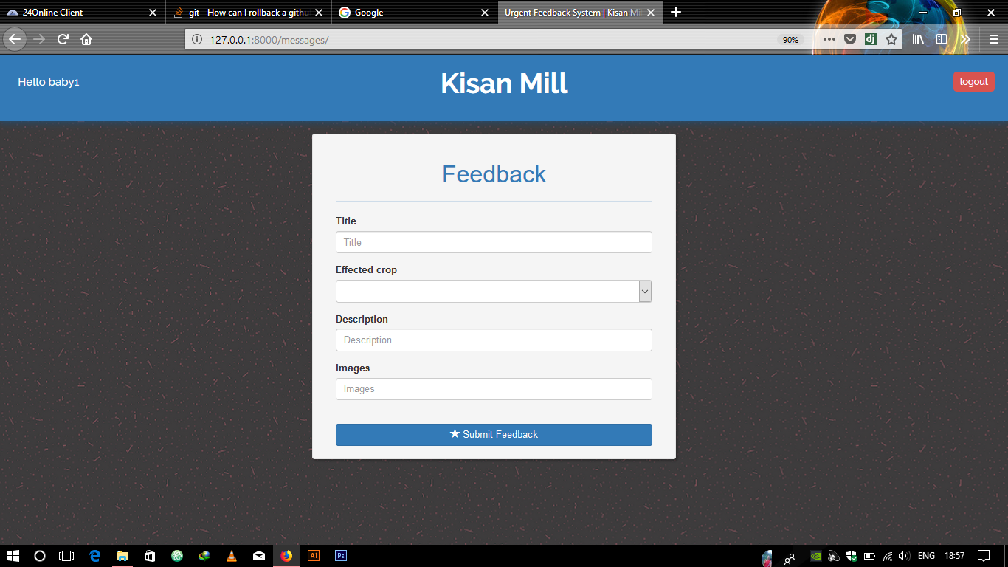
Urgent Feedback System
Farmers can directly submit the complaint of the diseases in the crops and the images can be linked via the link

Slide 14
Urgent Feedback System
Farmers can directly submit the complaint of the diseases in the crops and the images can be linked via the link

Slide 15
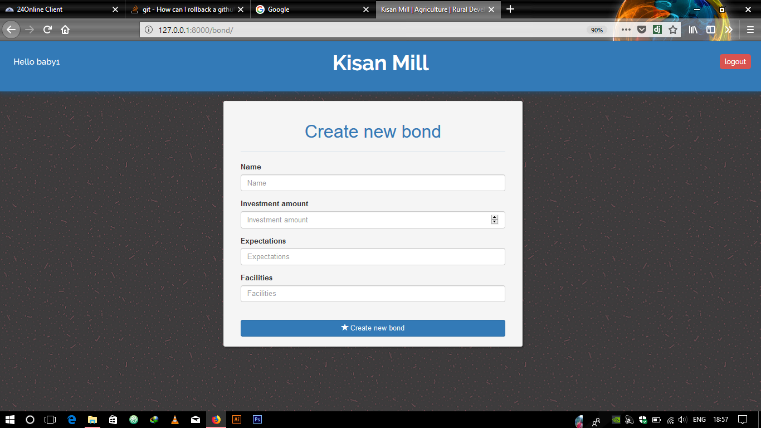
Creating a Bond
Although this feature is not mentioned in the documentation but this will help the farmers to create the bond between the investors and their land where they can ask for the their expectation in the portal.

Slide 16
Creating a Bond
Although this feature is not mentioned in the documentation but this will help the farmers to create the bond between the investors and their land where they can ask for the their expectation in the portal.

Slide 17
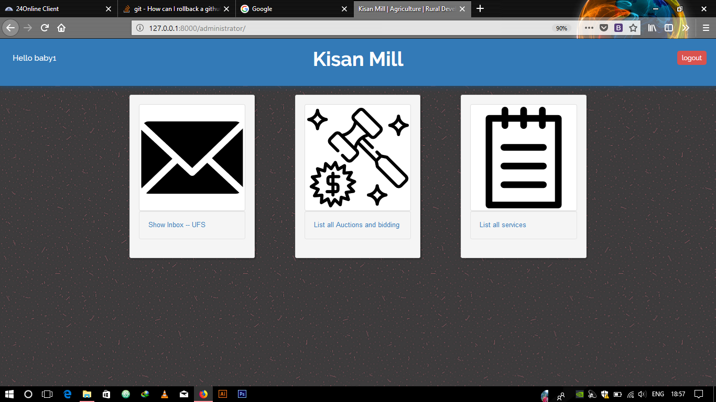
Admin Page and it’s functionality
Admin can see all the auctions and bidding happening on the platform
All services and the complaints which is received on the portal.

Slide 18
Admin Page and it’s functionality
Admin can see all the auctions and bidding happening on the platform
All services and the complaints which is received on the portal.

Slide 19
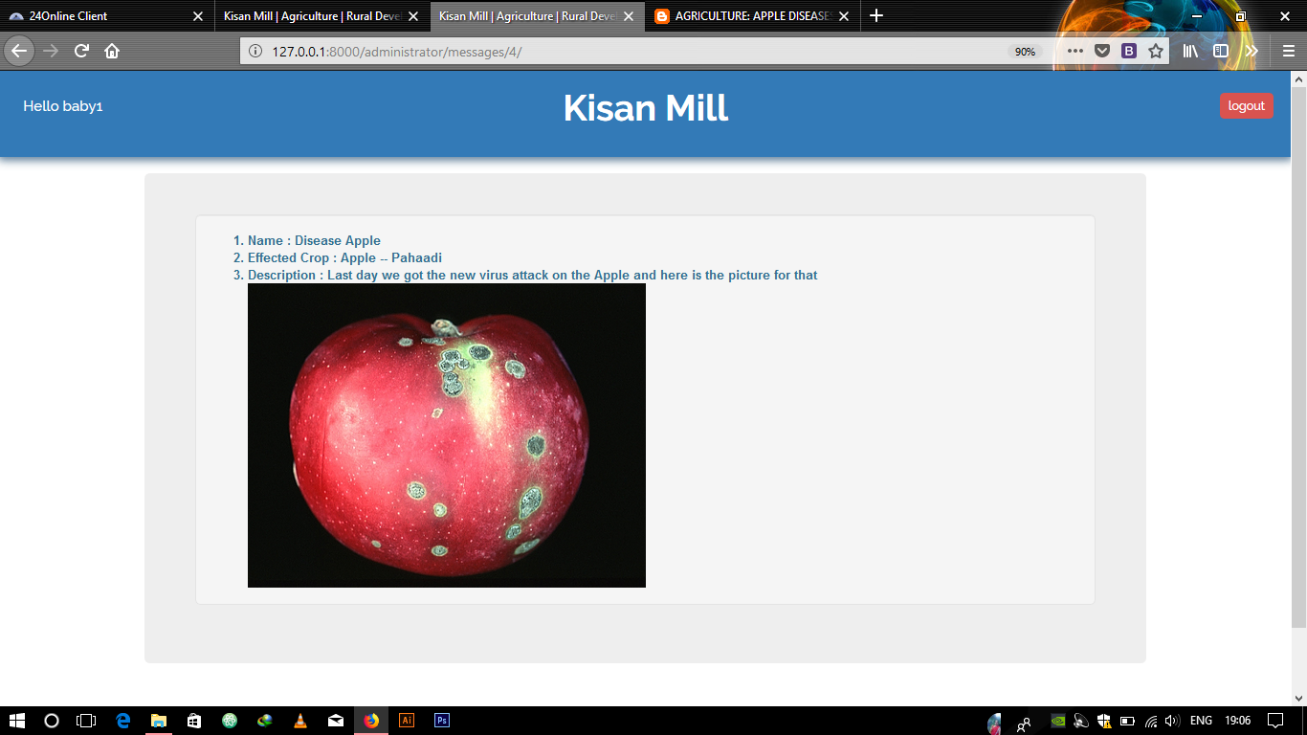
Details of the complaint in inbox
It shows all the disease happened on the product, so that agencies experts can go and check the product.

Slide 20
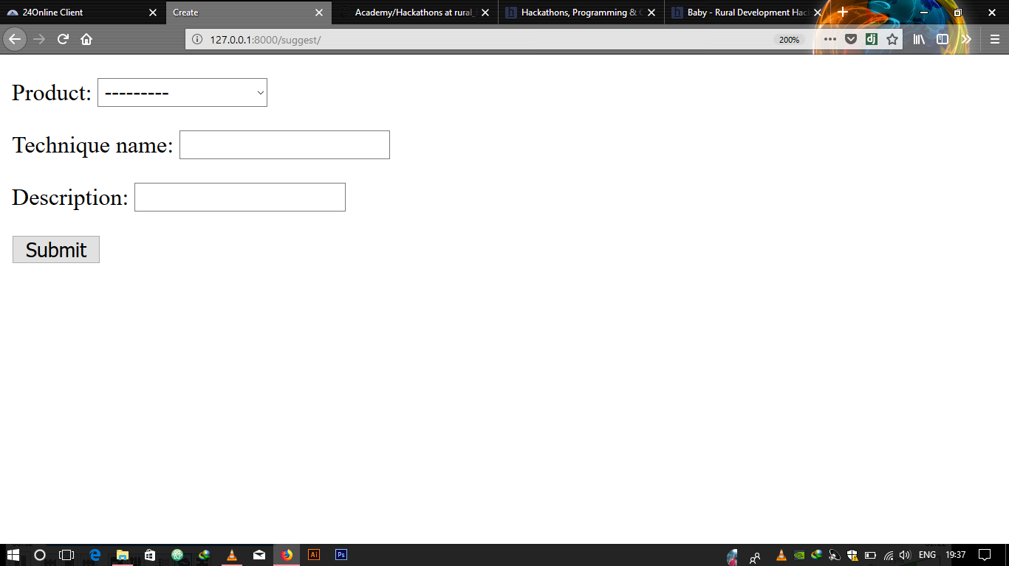
Students helping the farmers
This option is not yet implemented but it will help the students and experts to post their knowledge similar to stack overflow.

Slide 21

Thank you
Team : Baby

